Slide 1
Quiz Description
Design 5 Slides for 40min
Freestyle Background, Color, Font, and Size
Free Design, Transitions, and Animation
Free Text box, Icons, Chart, SmartArt, Pictures, and Shapes
Free cut and copy or reduce text that you want
Any way you want to design on your quiz
I will provide text and pictures to you for design on PowerPoint
Agenda and title will complete by students

Slide 2
Angkor Wat in Siem Reap, Cambodia is the largest religious monument in the world. Angkor Wat, translated from Khmer (the official language of Cambodia) literally means “City Temple.” As far as names go this is as generic as it gets. Angkor Wat was not the original name given to the temple when it was built in the 12th century. We have little knowledge of how this temple was referred to during the time of its use, as there are no extant texts or inscriptions that mention the temple by name—this is quite incredible if we consider the fact that Angkor Wat is the greatest religious construction project in Southeast Asia.
An aerial view of Angkor Wat demonstrates that the temple is made up of an expansive enclosure wall, which separates the sacred temple grounds from the protective moat that surrounds the entire complex (the moat is visible in the photograph at the top of the page). The temple proper is comprised of three galleries (a passageway running along the length of the temple) with a central sanctuary, marked by five stone towers.

Slide 3
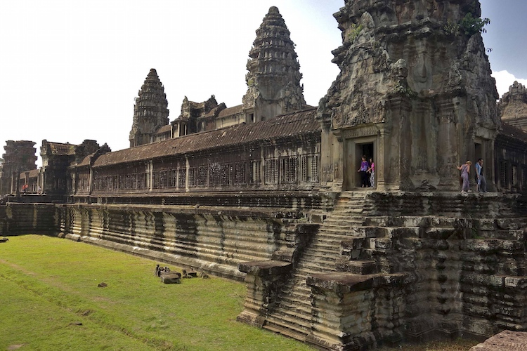
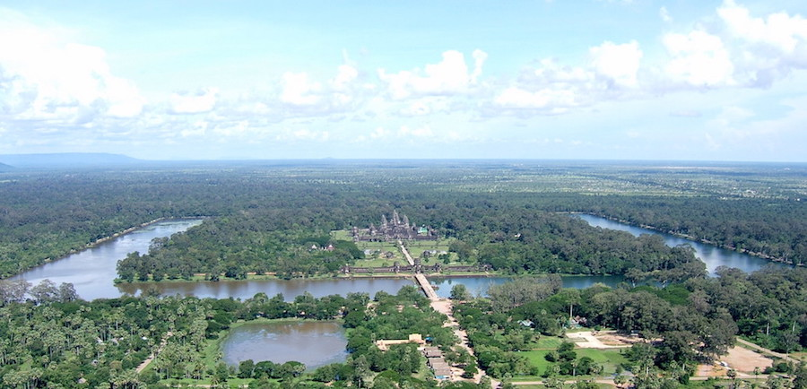
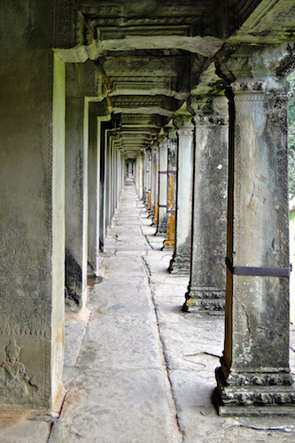
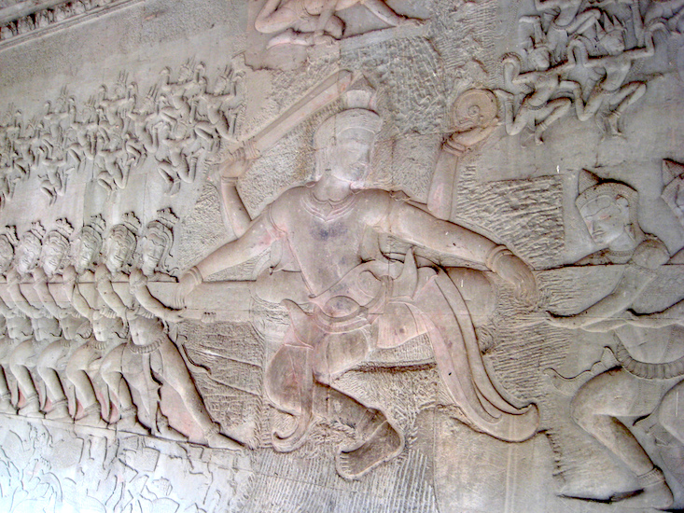
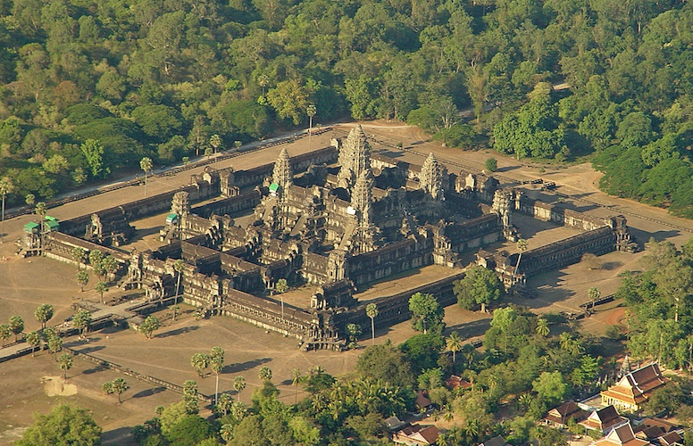
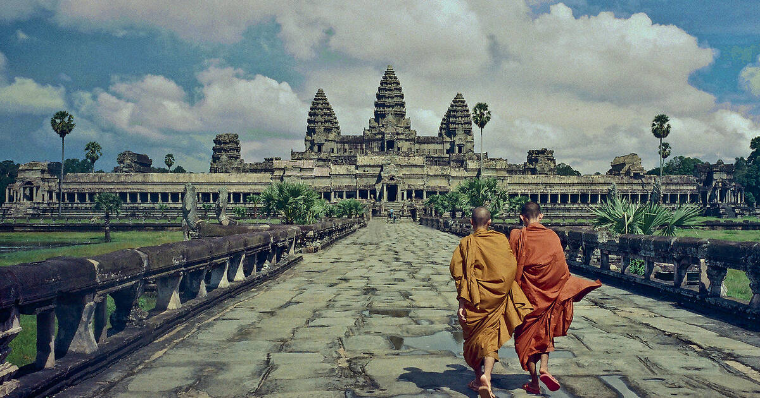

Slide 4





https://www.khanacademy.org/humanities/ap-art-history/south-east-se-asia/cambodia-art/a/angkor-wat
https://www.youtube.com/watch?v=dcWoW-YUCng
Tel: 099111111
Email: angkorwatcambodia@gmail.com
Location:Siem Reap city (13°24′N, 103°51′E), in Siem Reap Province.

Slide 5
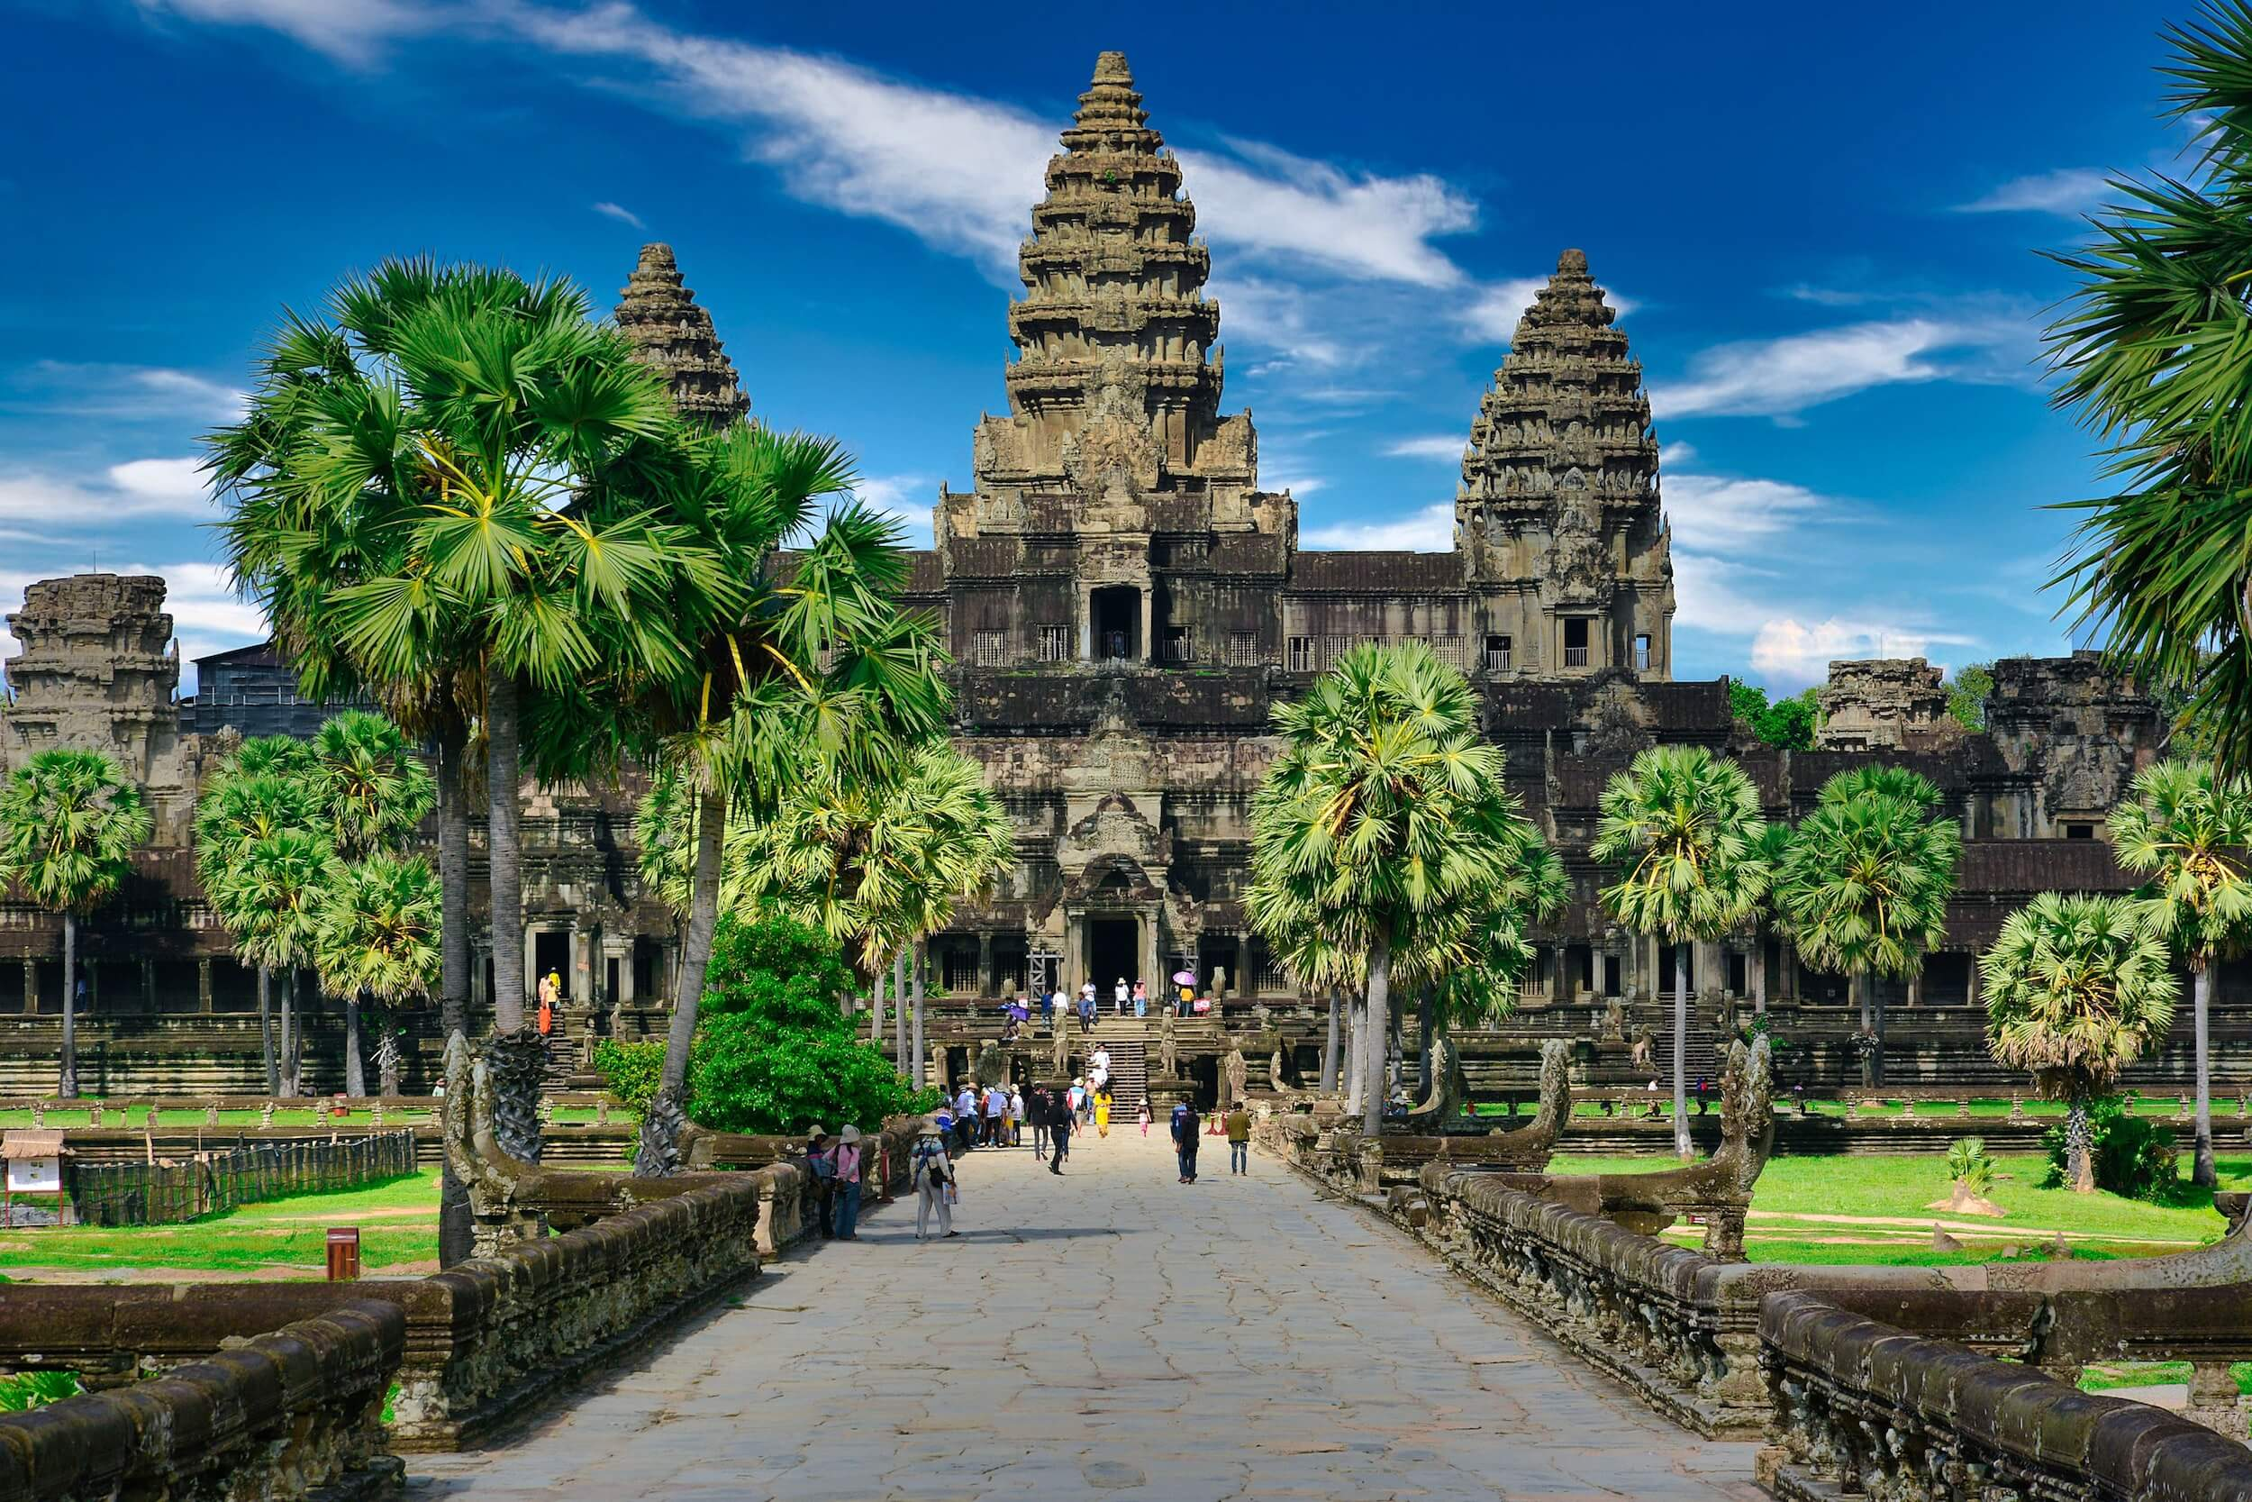
ANGKOR WAT TEAMPLE

Slide 6
Agenda
List of Khmer Popular Temples
Interesting things in Siem Reap
Some beautiful images of Khmer Temple
References

Slide 7
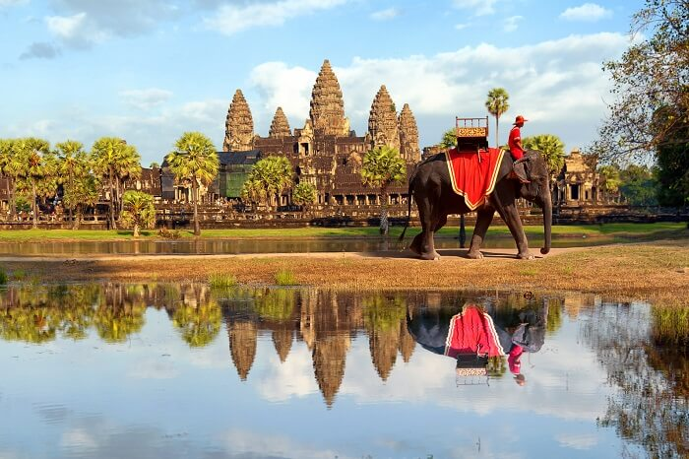
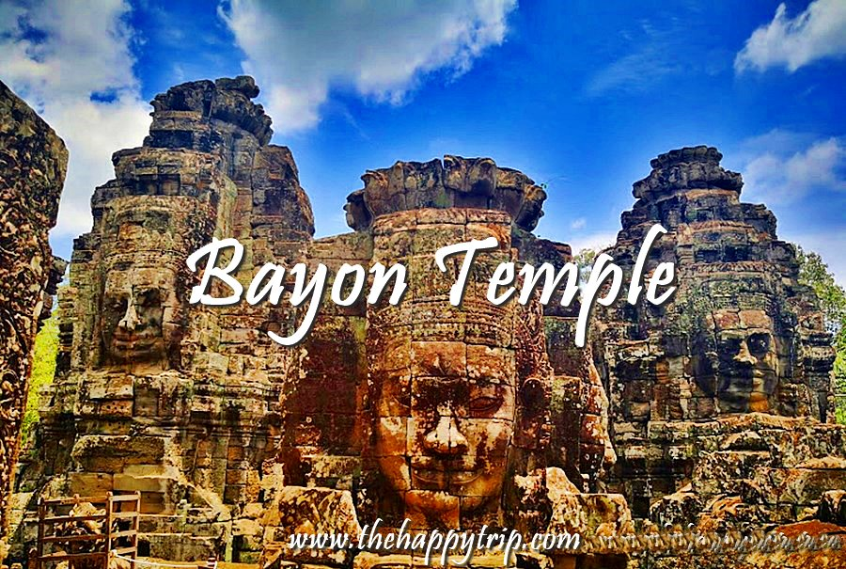
List of Khmer Popular Temples
Angkor Wat temple
Bayon temple

Slide 8
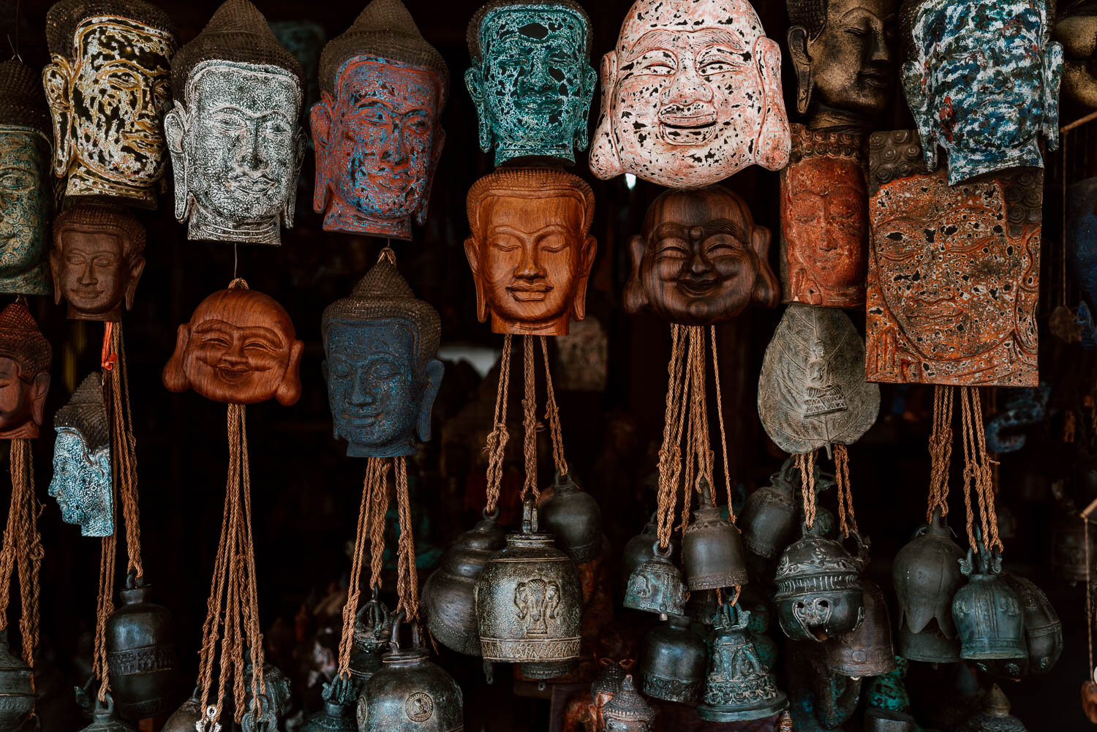
Interesting things in Siem Reap

Slide 9
Some beautiful images of Khmer Temple

Slide 10
References

